Slide 1


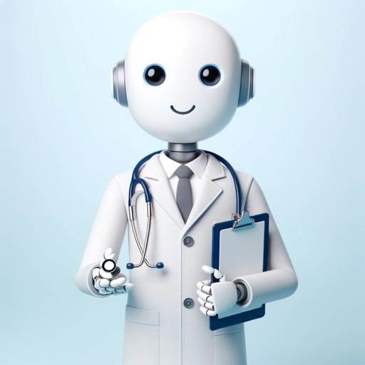

AVANTHI INSTITUTE OF ENGINEERING & TECHNOLOGY DEPARTMENT OF COMPUTER SCIENCE & ENGINEERING WITH SPECIALIZATION (DATA SCIENCE) BATCH NO : 08
ADVANCED HEALTHCARE CHATBOT FOR DISEASE DIAGNOSIS AND TREATMENT RECOMMENDATIONS
TEAM MEMBERS LODAGALA TEJA – 20Q71A4417 RATNALA MANASA – 20Q71A4427 VANAPALLI PRIYANKA -20Q71A4449
KONNA RAVI TEJA – 21Q75A4403
GUIDE NAME Dr. A CHANDRASEKHAR DIRECTOR – HR & PROFESSOR
Healthcare ChatBot

Slide 2
HealthCare Chatbot
CONTENTS
Overview
Abstract
Literature Survey
Existing System
Proposed System
Introduction
System Requirements
System Architecture
Modules
Data Collection
UML Diagram’s
Output Screenshots
Benefits
Features
Chatbot work’s
Challenges
Future Scope
Conclusion
References

Slide 3
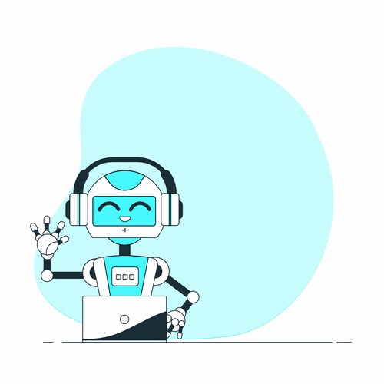
ABSTRACT
OBJECTIVE This system is aimed to provide medical diagnosis, suggestions and remedies based on the symptoms of a patient. The communication for the patient will be done using an automated medical chatbot.
Health care is very significant for you to live a well and healthy life. Often people do not know all the treatments or symptoms associated with a particular disease. For young people, users with the problem go to the hospital in person for a laborious test and it is very problematic to get a doctor's appointment for any health problems and managing phone calls. These types of problems can be solved by using Healthcare Chatbot by providing appropriate guidance regarding healthy living. The notion is to create a medical chatbot using Artificial Intelligence that can provide with the information and diagnose the disease and deliver basic information about the disease and when and where to consult a doctor. The effectiveness of medical chatbots rest on Natural language processing technique that helps users post their concerns about any disease and also their health. The user can ask any private question related to health care via chatbot without being actually present at the clinic or hospital. This will help reduce the cost of health care and improve access to medical information through medical chat-bot. The program development plan is to analyze customer feelings.
Healthcare ChatBot

Slide 4
LITERATURE SURVEY
[1] Bushra Kidwai, Nadesh RK, “Design and Development of Diagnostic Chabot for supporting Primary Health Care Systems”, International Conference on Computational Intelligence and Data Science (ICCIDS 2019)
[2] Papiya Mahajan, Rinku Wankhade, Anup Jawade, Pragati Dange, Aishwarya Bhoge, “Healthcare Chatbot using Natural Language Processing”, International Research Journal of Engineering and Technology (IRJET), Volume 07, Issue 11, Nov 2020
[3] Harsh Mendapara, Suhas Digole, Manthan Thakur, Anas Dange, “AI Based Healthcare Chatbot System by Using Natural Language Processing”, International Journal of Scientific Research and Engineering Development, Volume 4, Issue 2, Mar- Apr 2021
[4] Mr. Niraj A. Wanjari, et.al., “AI Healthcare Chatbot Using Natural Language Processing”, International Research Journal of Modernization in Engineering Technology and Science, Volume 04, Issue 05, May-2022
[5] M.V. Patil, Subhawna, Priya Shree, Puneet Singh, “AI based healthcare chat bot system”, International Journal of Scientific & Engineering Research, Volume 12, Issue 7, July-2021
[6] Lekha Athota, Vinod Kumar Shukla, Vinod Kumar Shukla, Ajay Rana, “Chatbot for Healthcare System Using Artificial Intelligence”, 2020 8th International Conference on Reliability, Infocom Technologies and Optimization (Trends and Future Directions) (ICRITO) Amity University, Noida, India. June 4-5, 2020

Slide 5
LITERATURE SURVEY
PAPER TITLE | APPROACH | OUTCOME
Web-based chatbot for frequently asked queries (FAQ) in hospitals | The bot engine was integrated by several machine learning approaches like gradient descent (GD) and natural language processing (NLP) algorithms. | Results The employed ML algorithms were successfully incorporated to manage the alternative synchronization of text and voice messages.
Chatbot for disease prediction and treatment recommendation using machine learning | This research intends to apply the concepts of natural language processing and machine learning to create a chatbot application. | According to this research, such a system is not widely used, and people are less aware of it.
Chatbot for healthcare system using artificial intelligence | The idea is to create a medical chatbot using Artificial Intelligence that can diagnose the disease and provide basic details about the disease before consulting a doctor. | The third party, the expert program, handles the question presented to the bot that is not understood or is not present in the database.
Development of artificial intelligence based chatbot using deep neural network | A deep neural network is created using tensor flow API, and the speech recognition function is defined for the input query and output response. | The information is delivered in both speech and text modes using the proposed methodology.

Slide 6
EXISTING SYSTEM
Many of the existing systems have chats through texts. Some limitations of such Chatbots are, there is no instant response given to the patient, they have to wait for expert's acknowledgement for a long time. And also, there are a limited number of diseases in the dataset. Technical issues like voice messages are not accurate in the existing system.
LIMITATIONS
Limited Context Understanding
Dependency on Knowledge Base Accuracy
Speech Recognition Challenges
Lack of Emotional Intelligence
Inability to Handle Unforeseen Scenarios
Privacy Concerns
Limited Learning Capabilities
User Trust and Acceptance
Integration Challenges
Resource Intensive

Slide 7
PROPOSED SYSTEM
In our system the user can interact with the chatbot through text and chat bot will interact using voice and text manner. With respect to the user's queries, the bot identifies the disease if user chatting with the chatbot. According to the diseases of the user, bot gives suggestions for the disease and also prescribe specialist doctors. This system can be used by multiple users at a time without any lagging.
ADVANTAGES
24/7 Accessibility and Availability
Voice Input by User (Speech to Text)
Voice Output by Bot (Text to Speech)
User-Friendly Interface and Natural Language Processing
Continuous Learning and Improvement
Privacy Preservation and Data Security

Slide 8
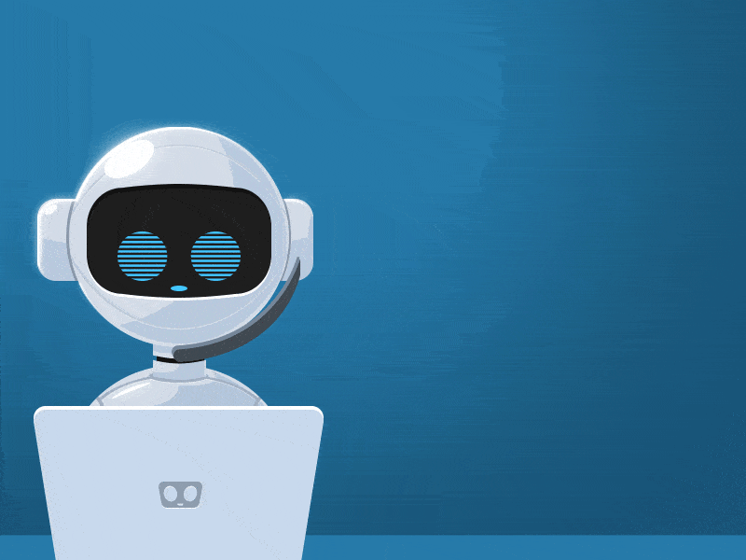
Introduction to Health Care Chatbot
Healthcare ChatBot
A chat bot is a system that can interact with human users with natural language. Chat bots are used in domains like Customer Support, Virtual Assistance, Online Training, and Online Reservations and also for general conversations. In our proposed system, a medical chat bot is developed which can provide many diagnosis, suggestions and remedies to the patients based on their symptoms. It can act as an emergency support for a patient whereas a doctor's visit can take some time. It is also useful for home-based diagnosis system. The system focuses on the messages that the user provides while initiating the conversation. The idea behind this is to detect the preliminary symptoms and the problems that the user may be experiencing.
Advanced health care chatbots are revolutionizing the way individuals access medical information and support. These intelligent virtual assistants are designed to provide personalized health advice, assist in scheduling appointments, and offer informative resources.

Slide 9
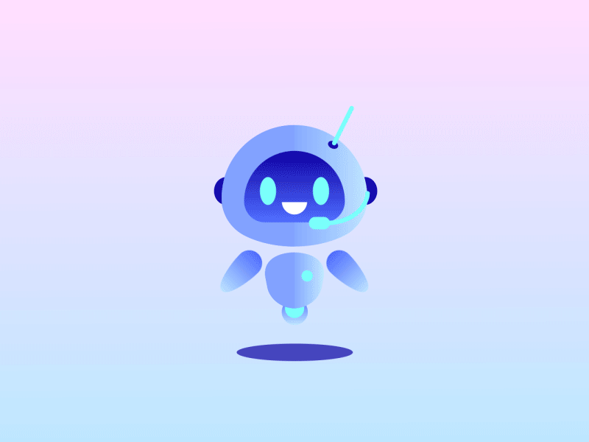
SYSTEM REQUIREMENTS
SOFTWARE REQUIREMENTS
Operating System | Windows 10/11
Development Software | Python 3.10
Programming Language | Python
Domain | Artificial Intelligence
Integrated Development Environment (IDE) | Visual Studio Code
Front End Technologies | HTML5, CSS3, Java Script
Back End Technologies or Framework | Django
Database Language | SQL
Database (RDBMS) | MySQL
Database Software | WAMP or XAMPP Server
Web Server or Deployment Server | Django Application Development Server
Design/Modelling | Rational Rose
HARDWARE REQUIREMENTS
MINIMUM (Required for Execution) |  | MY SYSTEM (Development)
System | Pentium IV 2.2 GHz | i3 Processor 5th Gen
Hard Disk | 20 GB | 500 GB
Ram | 1 GB | 4 GB

Slide 10

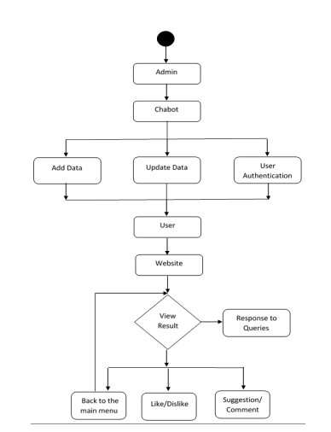
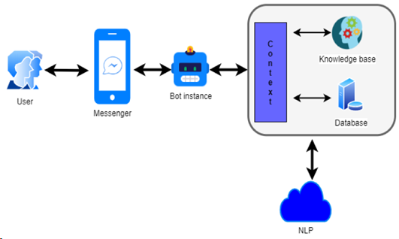
Healthcare Chatbot Flow Chart
SYSTEM ARCHITECTURE

Slide 11
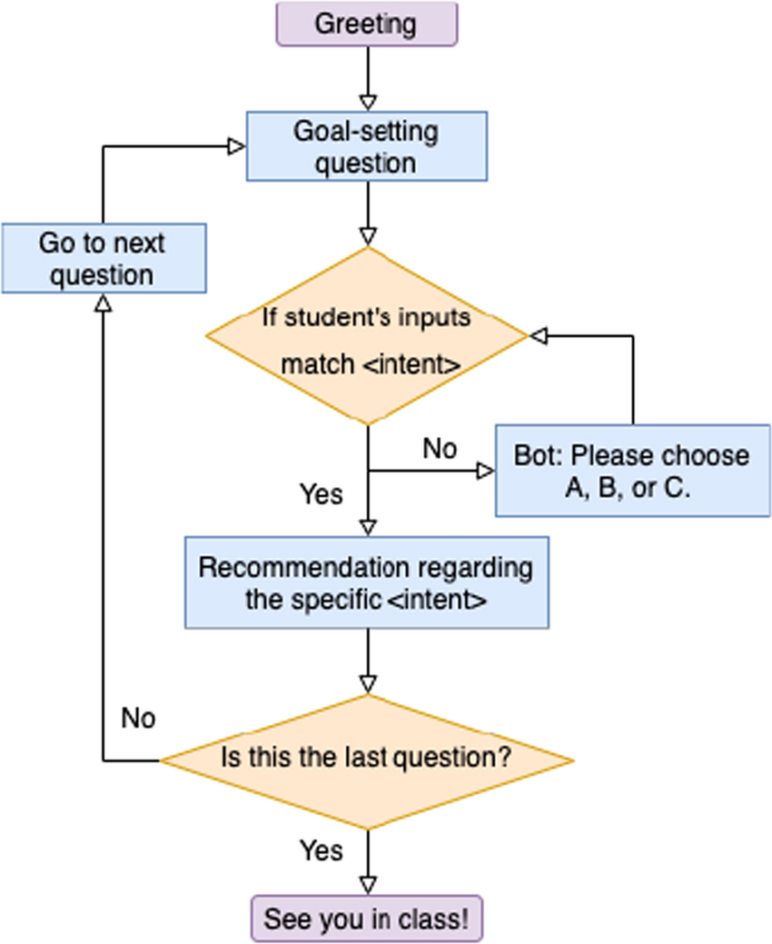
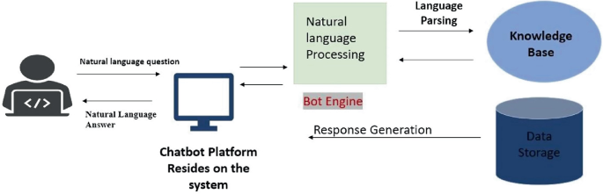
METHODOLOGY
Healthcare ChatBot

Slide 12
MODULES
User Interaction Module
This module encompasses the user interface and interaction components. It allows users to engage with the chatbot using both text and voice commands. It includes features for processing user queries, understanding intent, and providing responses in a user-friendly manner.
Artificial Intelligence (AI) and Knowledge Base Module
The AI and Knowledge Base module is the core intelligence of the system. It includes Natural Language Processing (NLP) algorithms for interpreting user queries and a real-time knowledge base in JSON format. This module enables the chatbot to retrieve and process relevant healthcare information to respond to user inquiries.
Healthcare Functionality Module
This module incorporates various healthcare functionalities such as symptom diagnosis, doctor recommendations, and immediate measure suggestions. It leverages predictive analysis capabilities to anticipate potential health issues based on user-provided data. The module is designed to assist users in making informed decisions about their health.
Communication and Multi-Modal Interaction Module
The Communication module integrates speech recognition and Text-to-Speech (TTS) functionalities. It enables users to interact with the chatbot through voice commands and receive responses in both text and speech formats. This multi-modal interaction enhances user experience and accessibility.
Security and Integration Module
The Security and Integration module addresses privacy concerns and system integration challenges. It includes measures such as data encryption, user authentication to healthcare privacy regulations.

Slide 13
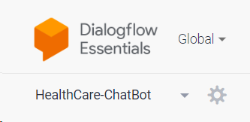
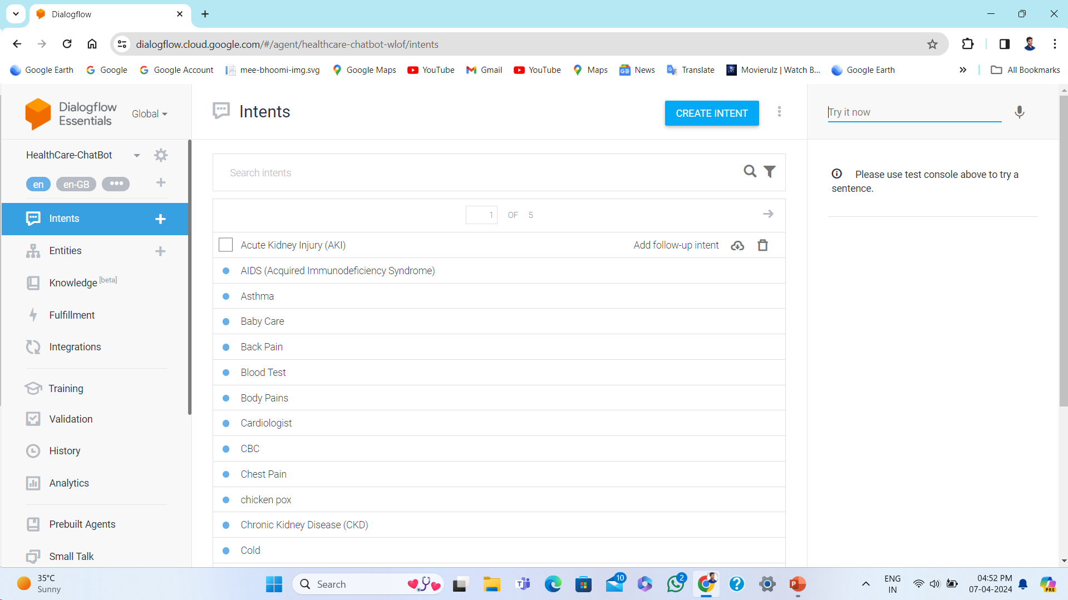
DATA COLLECTION
DIALOGFLOW-CONSOLE
Dialogflow is defined as a Google service which operates on a Google Cloud Platform. The Dialogflow is an intuitive and user-friendly tool that includes some Google products such as Google Cloud Speech-to-Text and Google's machine learning expertise. It is mainly used to build actions for most of the Google Assistant devices.
In other words, Dialogflow is defined as an NLP (Natural Language Processing) platform, which is used to develop an application related to the conversations and experience for the customers of the company in different languages on numerous platforms. By using Google-powered, products developers can design text-based and voice-conversation interfaces in order to answer the queries of customers in various languages. For example - various companies use Dialogflow to make messaging bots that reply to the queries of the customers on different platforms such as Google Assistant, Slack, Facebook Messenger, Alexa Voice Search (AVS), etc.
SIZE OF THE INTENTS = 731-800 KB

Slide 14
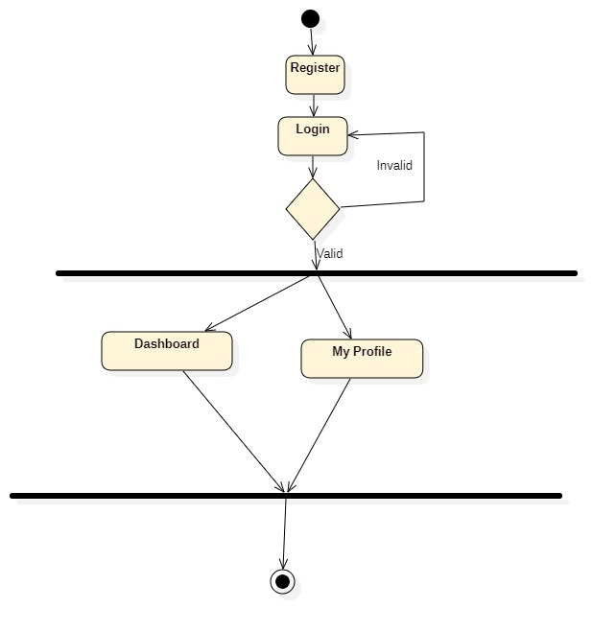
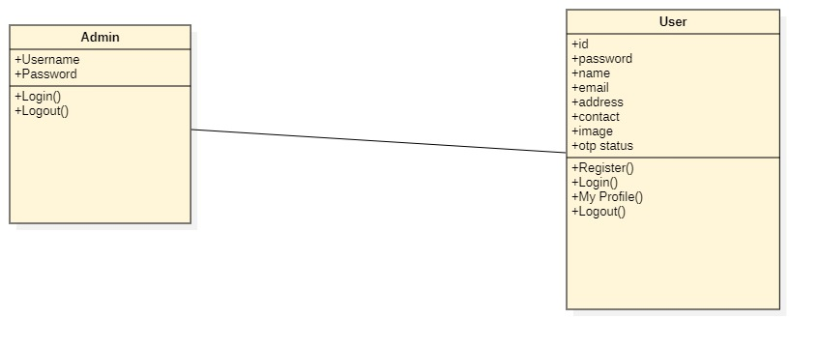
UML DIAGRAMS
ACTIVITY DIAGRAM
CLASS DIAGRAM

Slide 15
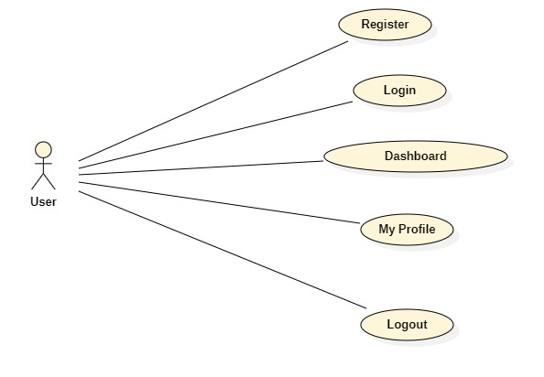
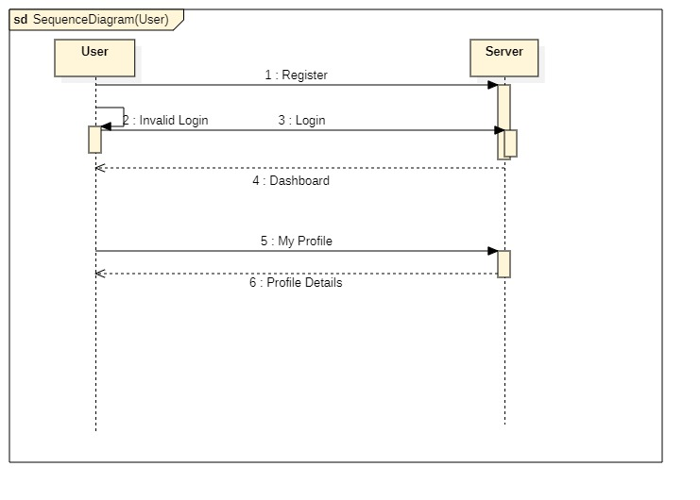
UML DIAGRAMS
USE CASE DIAGRAM
SEQUENCE DIAGRAM

Slide 16
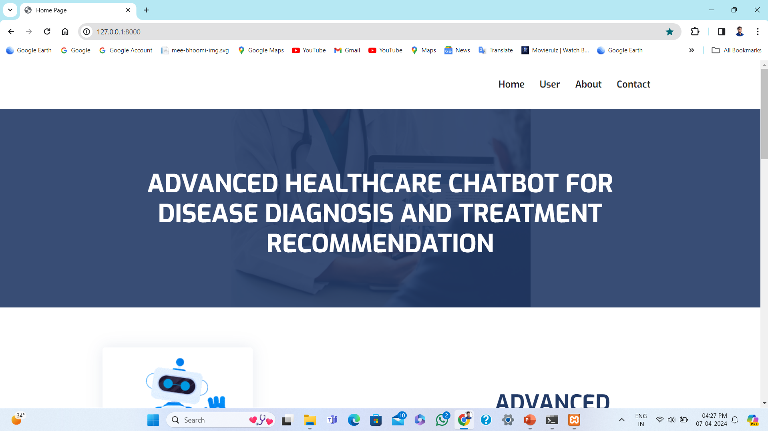
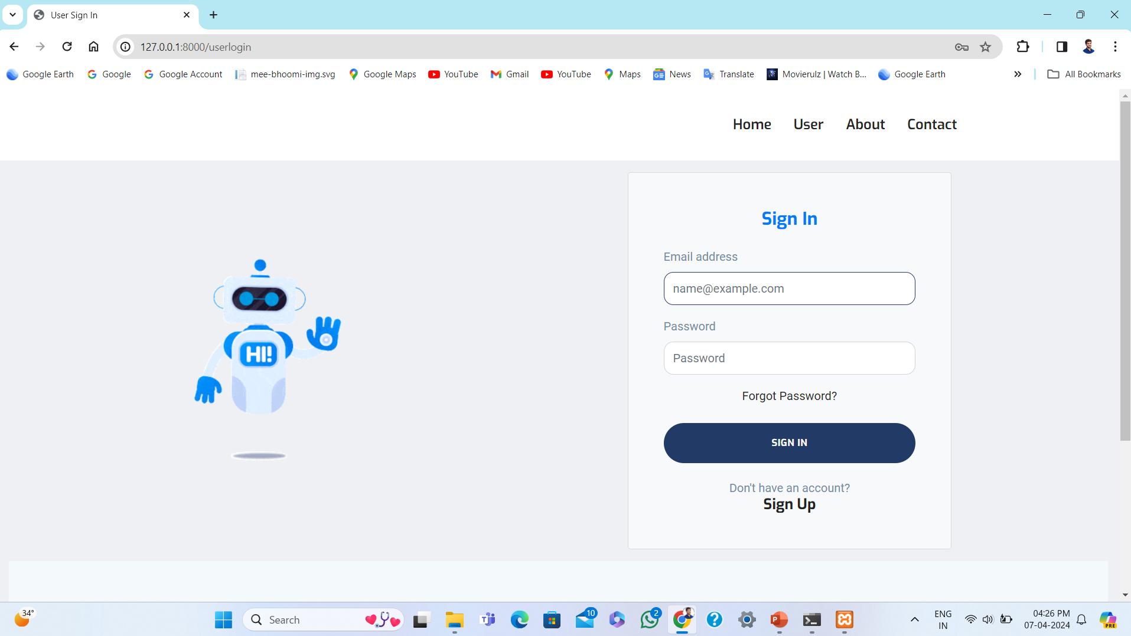
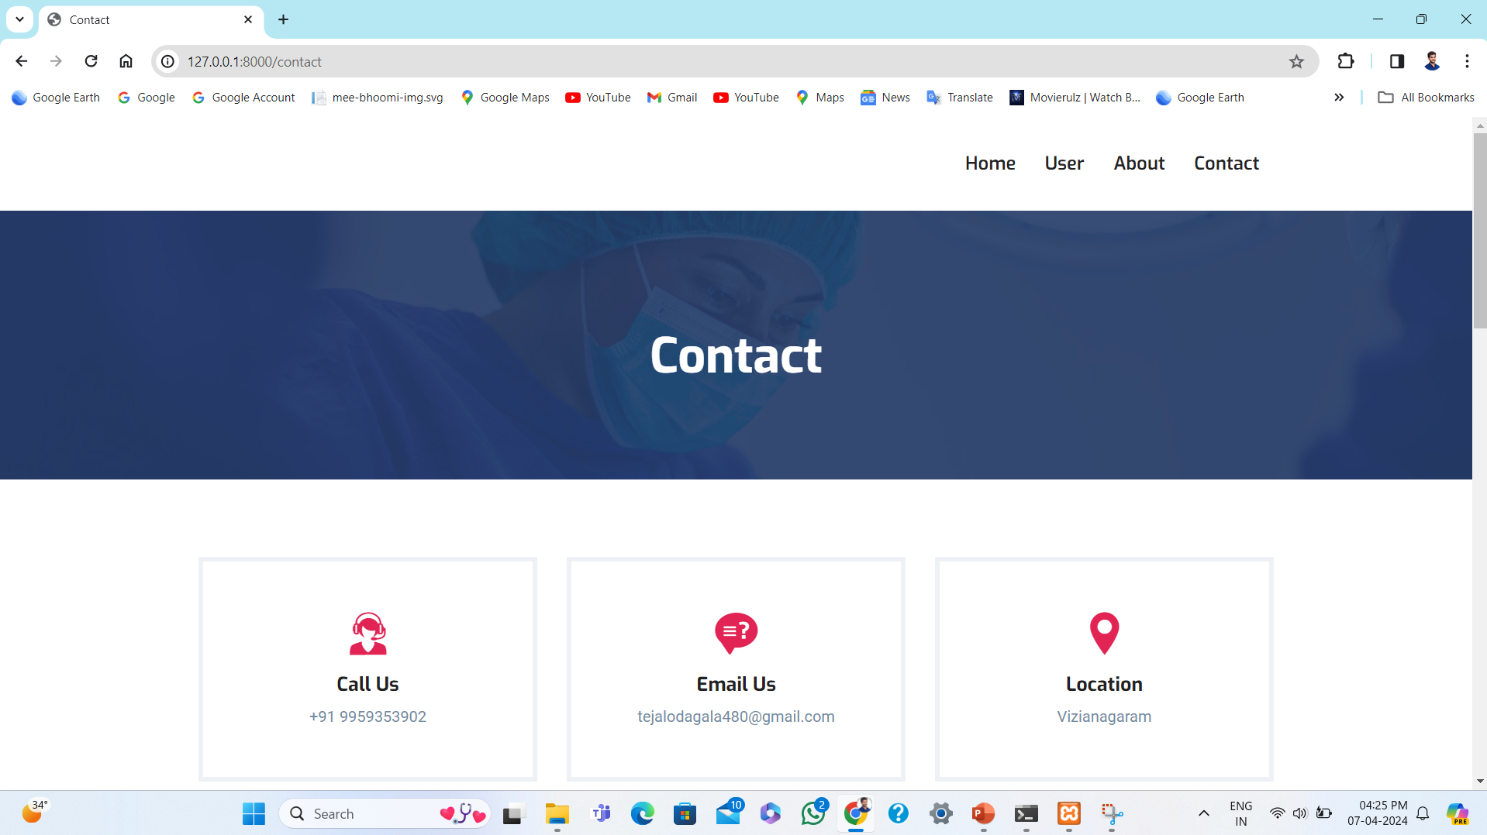
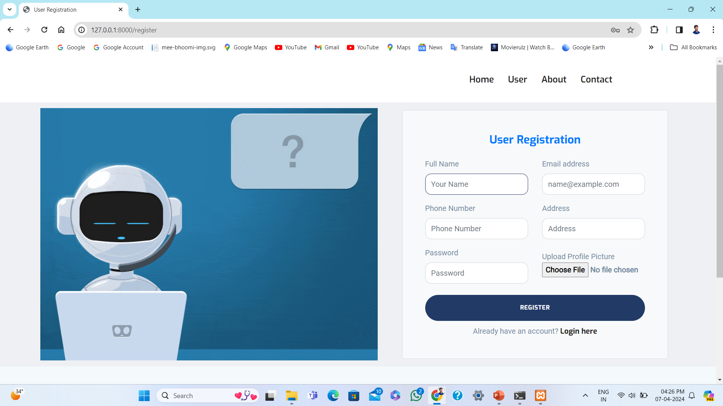
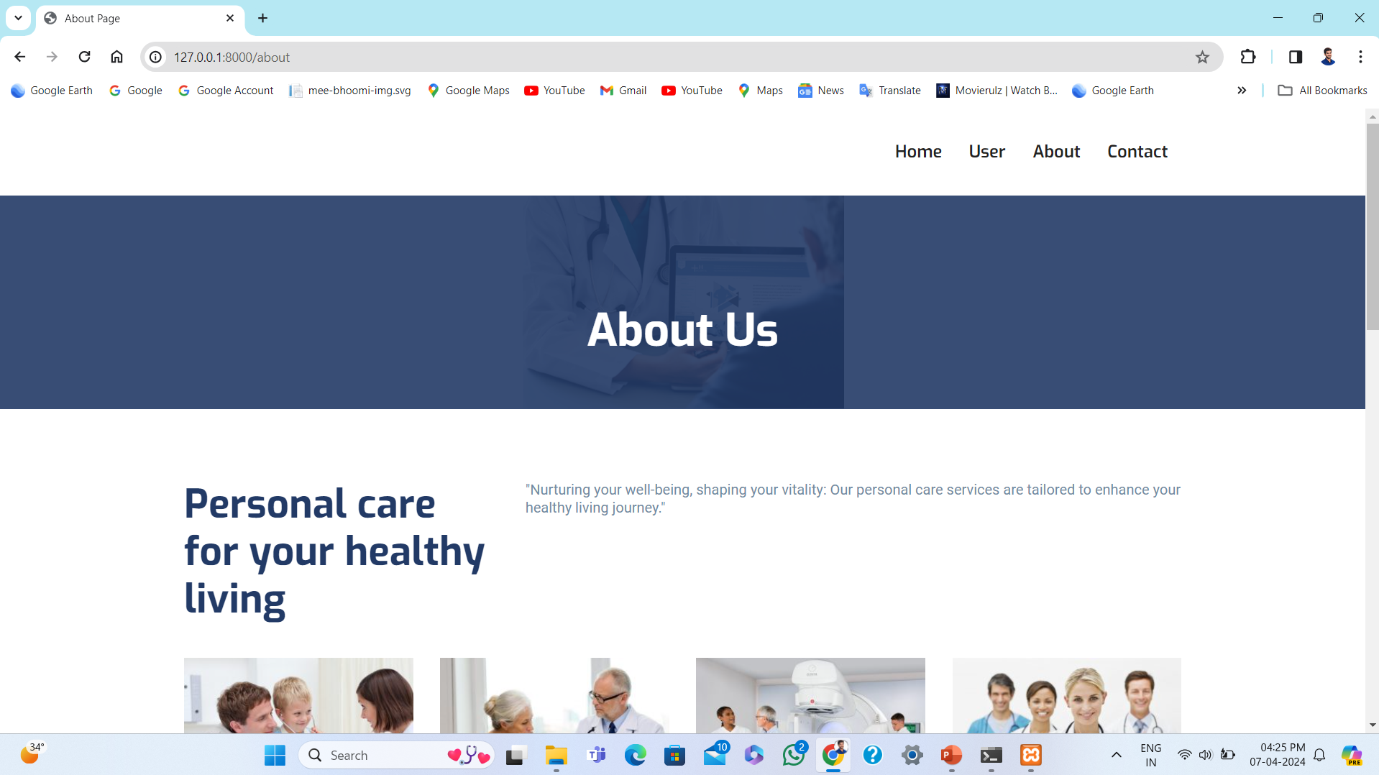
OUTPUT SCREENSHOT’S

Slide 17
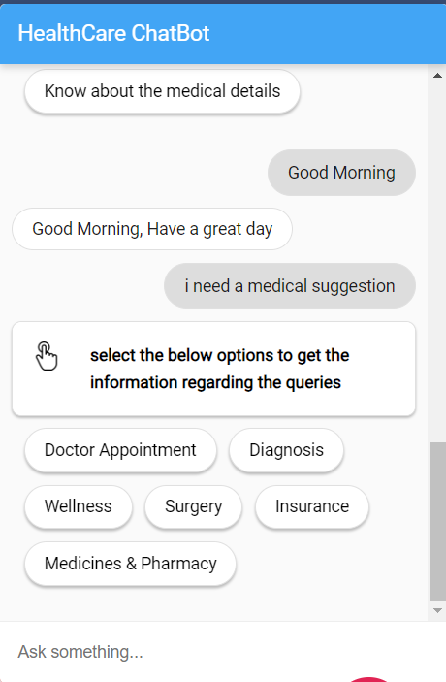
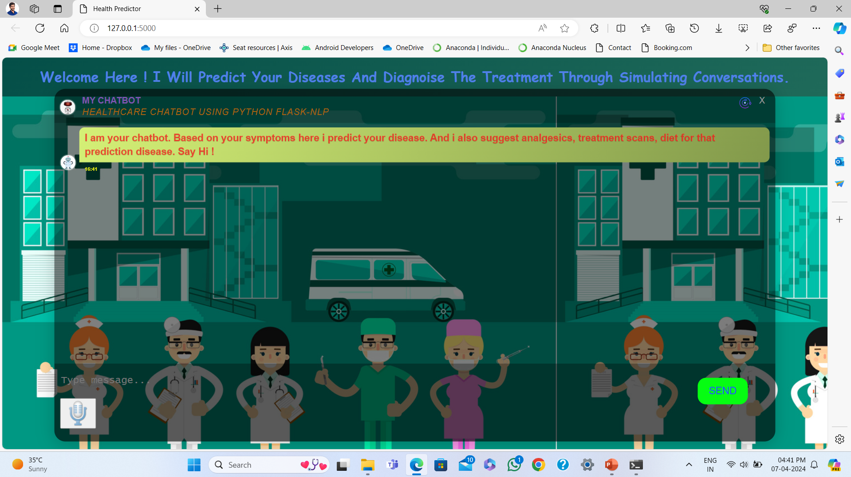
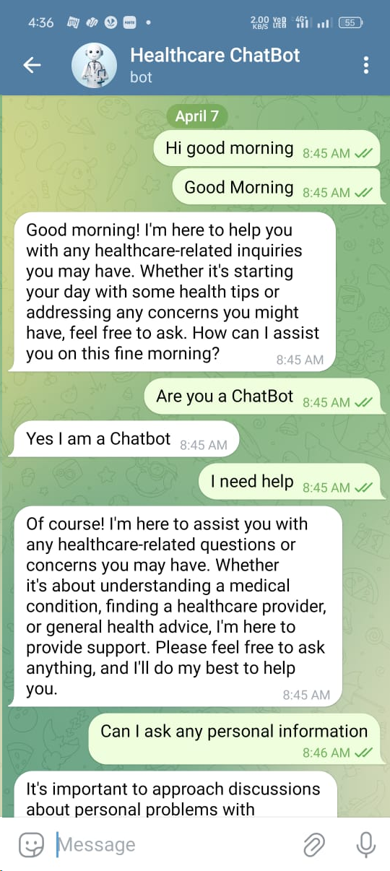
OUTPUT SCREENSHOT’S
TEXT BASED WEB APPLICATION
TEXT- VOICE BASED CHATBOT
TELEGRAM BOT

Slide 18
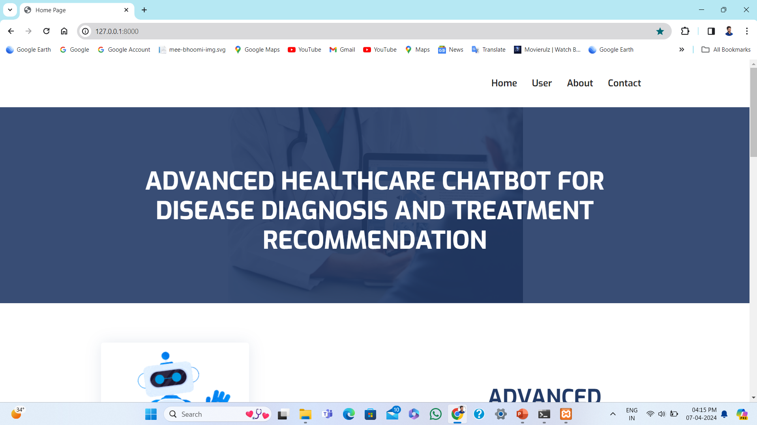
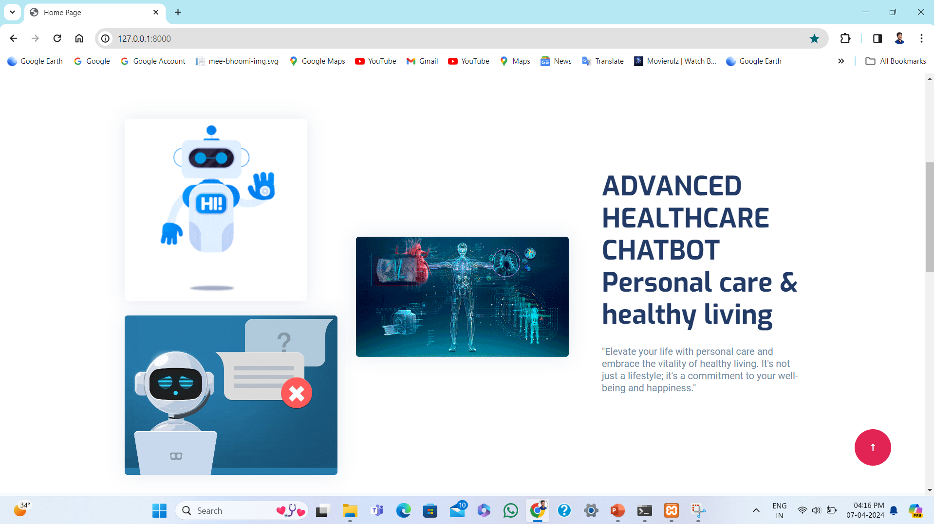
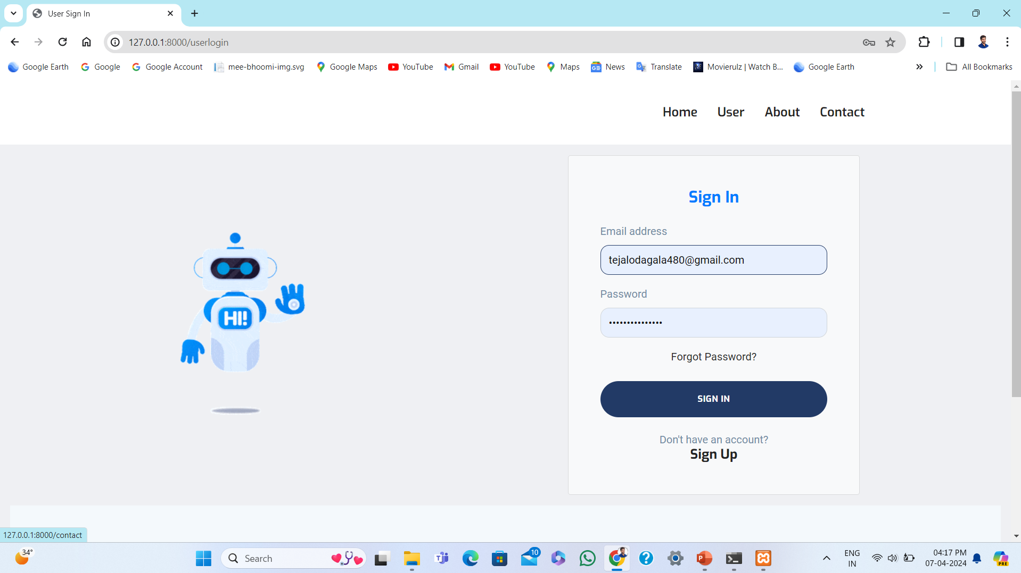
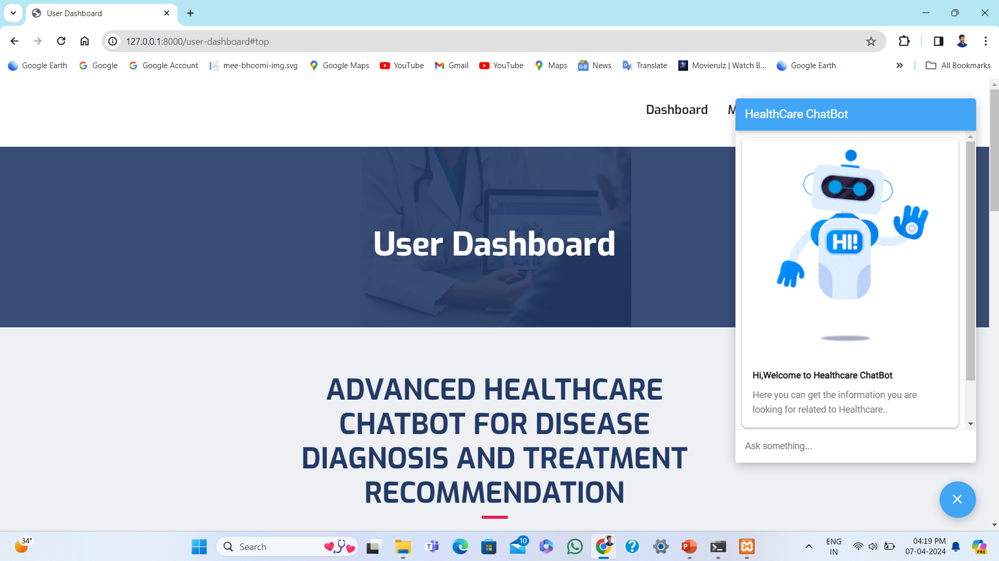
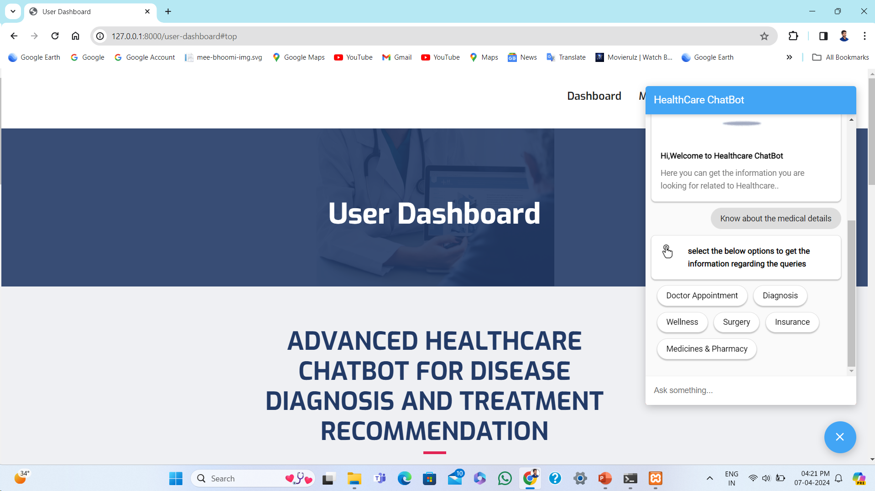
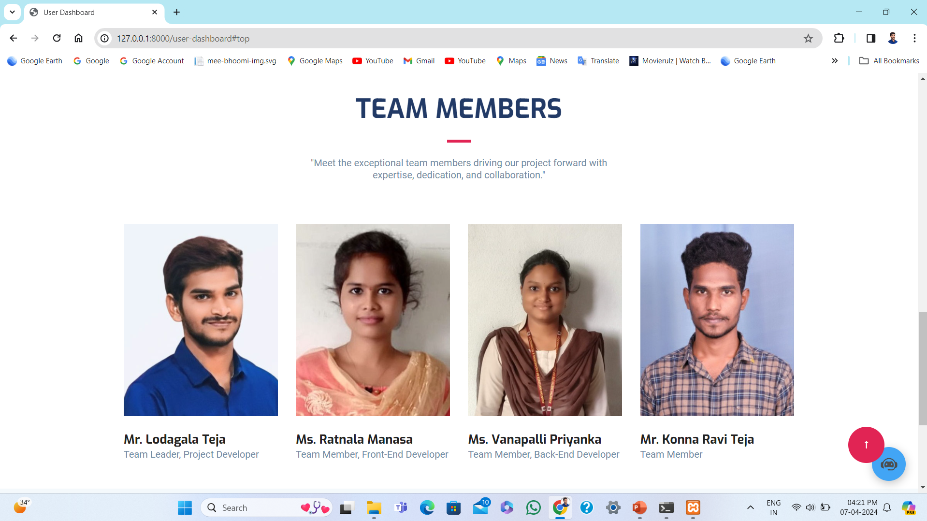
OUTPUT SCREENSHOT’S

Slide 19
BENEFITS OF USING A HEALTH CARE CHATBOT
Accessible 24/7
Personalized Care
Chatbots provide round-the-clock assistance, offering immediate support for health inquiries.
Customized recommendations and health advice tailored to the individual's needs and medical history.
Educational Resources
Reduction in Wait Times
Delivers relevant health information, promoting better understanding and awareness of medical conditions.
Minimizes delays for appointments and inquiries, enhancing overall efficiency in healthcare delivery.

Slide 20
FEATURES OF AN ADVANCED HEALTH CARE CHATBOT
Integration with Wearable Devices
Multilingual Capabilities
Personalized Health Advice
24/7 Access
Advanced chatbots can provide tailored health recommendations based on user input and medical history.
Users can access the chatbot at any time for quick responses to health-related queries.
The chatbot can sync with wearable tech to monitor and analyze real-time health data.
Capable of communicating in multiple languages to accommodate diverse user populations.

Slide 21
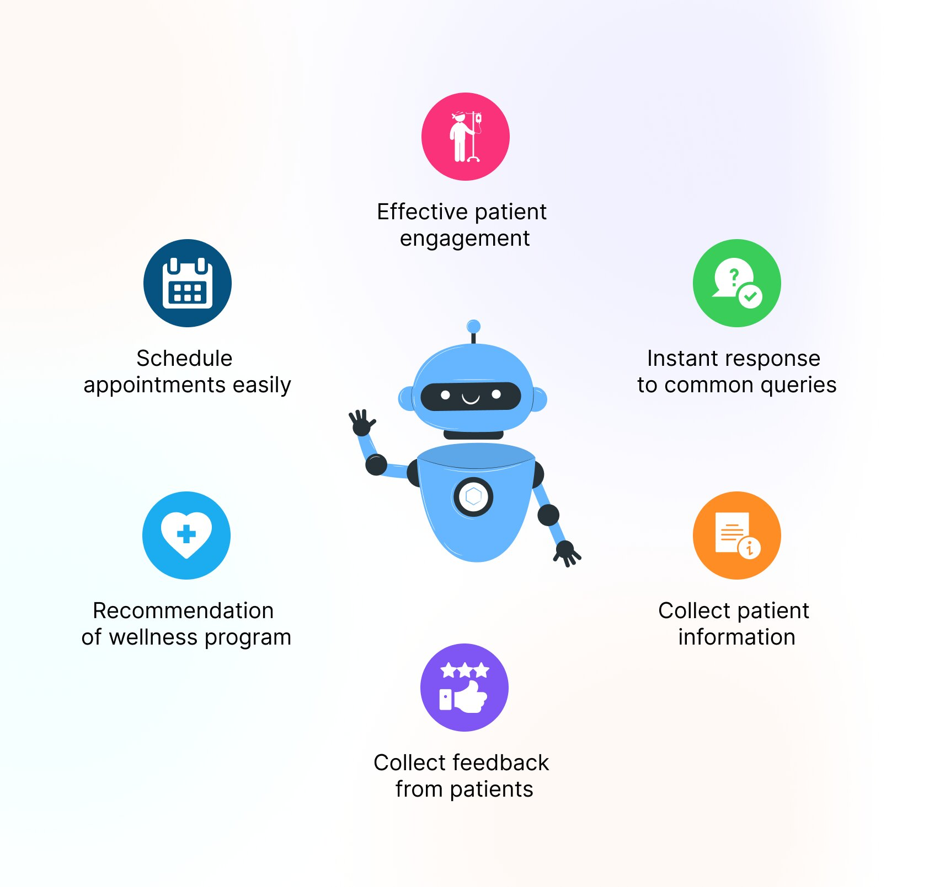
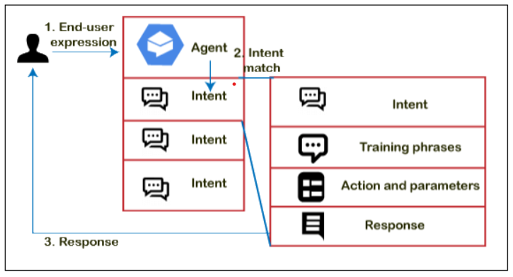
HOW A HEALTH CARE CHATBOT WORKS
Healthcare ChatBot
A health care chatbot works by using artificial intelligence to interact with users, analyze their input, and provide relevant information and assistance.
It employs natural language processing to understand and respond to user queries efficiently, offering personalized recommendations and support.

Slide 22




CHALLENGES IN DEVELOPING AN ADVANCED HEALTH CARE CHATBOT
Data Privacy
1
Protecting sensitive medical information
Accuracy and Reliability
2
Ensuring correct diagnosis and advice
Integration with Complex Systems
3
Connecting with electronic health records

Slide 23

FUTURE TRENDS IN HEALTH CARE CHATBOT TECHNOLOGY
Advanced AI Integration
Personalized User Experience
Virtual Assistant Capabilities
AI will be seamlessly integrated for more accurate and personalized responses.
Chatbots will offer highly personalized interactions tailored to each user's unique needs.
Health care chatbots will evolve into sophisticated virtual assistants with advanced functionalities.

Slide 24
CONCLUSION AND KEY TAKEAWAYS
Health care chatbots are revolutionizing the provision of medical information and support. They offer accessibility, convenience, and personalized assistance, leading to better health outcomes. However, ensuring privacy, security, and ethical use remains paramount. The future promises further innovation and integration opportunities within healthcare systems.

Slide 25
REFERENCES
[1] M. Mittal, B. Gopi, D. Singh, T. Nagarwal, P. Yadav, "Web-based chatbot for frequently asked queries (FAQ) in hospitals", Journal of Taibah University Medical Sciences, vol. 16, no. 5, pp. 740-746, 2021.
[2] R. B. Mathew, S. Varghese, S. E. Joy and S. S. Alex, "Chatbot for disease prediction and treatment recommendation using machine learning", 3rd Int. Conference on Trends in Electronics and Informatics, pp. 851-856, 2019.
[3] L. Athota, V. K. Shukla, N. Pandey and A. Rana, "Chatbot for healthcare system using artificial intelligence", 8th Int. Conference on Reliability, Infocom Technologies and Optimization, pp. 619-622, 2020.
[4] D. S. Rao, K. L. Srikanth, J. Noshitha P. Pratyusha, M. Sucharitha, M. Tejaswini and T. Ashwini, "Development of artificial intelligence based chatbot using deep neural network", In: P. Raju and P. K. Shukla (eds), SCRS conference proceedings on intelligent systems, pp.143-151, 2021.
[5] J. Weizenbaum, “ELIZA- A computer program for the study of natural language communication between man and machine”, CACM, vol. 9, no. 7, pp. 36-43, 1996.

Slide 26
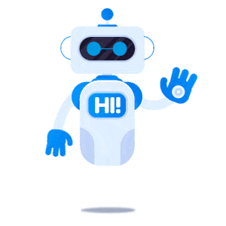
THANK YOU

